Slide 1

Hero image
[Gina Giase, Alex Kimbrough, Jade Lopez]
Notes:
Rockwell heading 48, subtitle 36, normal text 18

Slide 2

Intro slides
Quick research problem description (1-2 sent max)
Background of cybersecurity as an industry, burden of health data and thus security in healthcare system, US and globally
**Sell problem of why we need cybersecurity in healthcare**
Notes:
Big Data numbers in general
Healthcare big data volume
Cybersecurity-Big brother
Ease of analysis, computation, and validation-big Butler

Slide 3
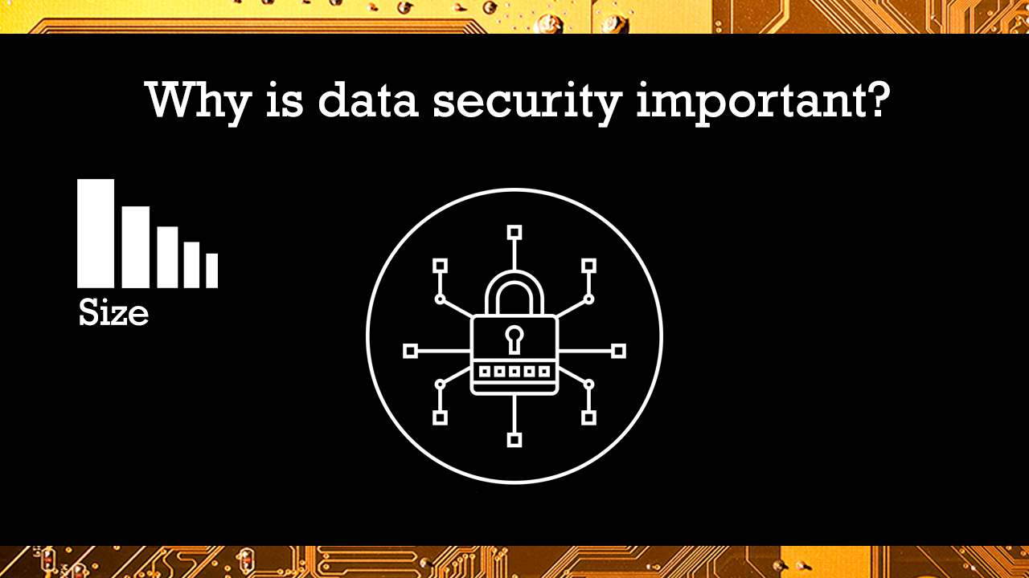

Slide 4
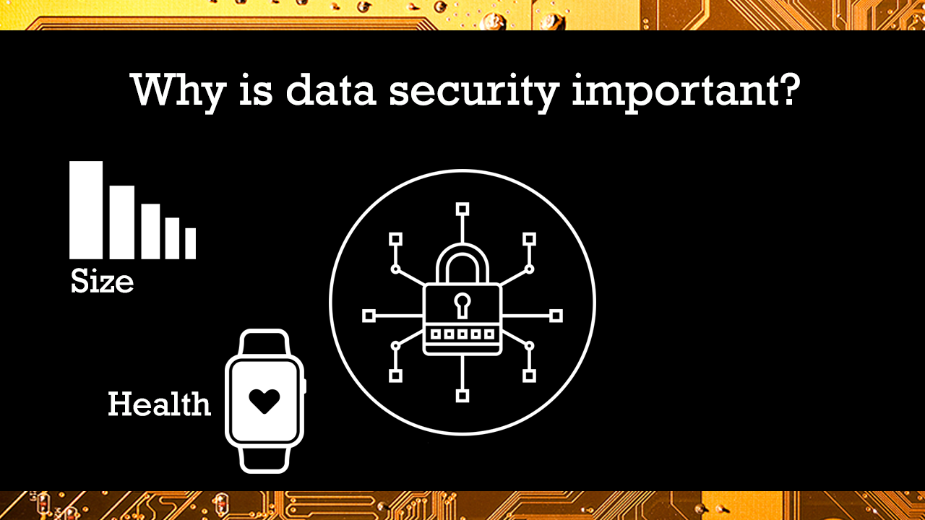

Slide 5
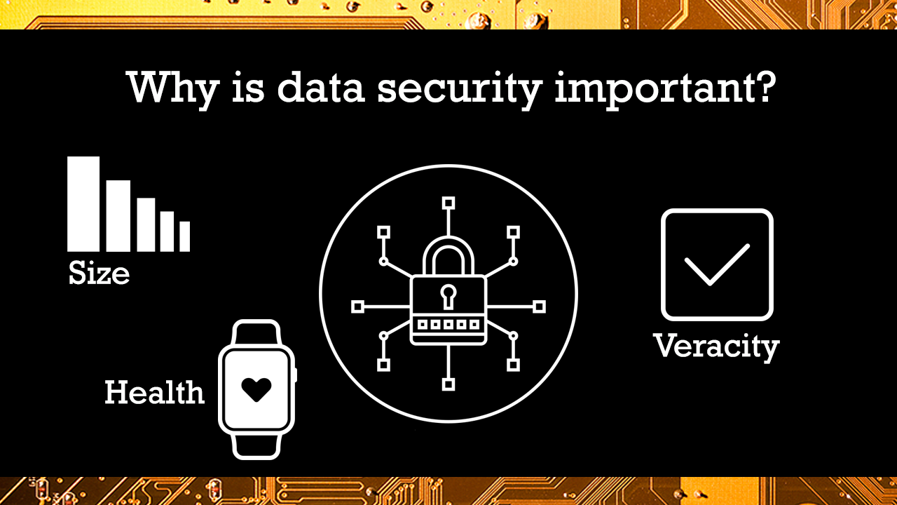

Slide 6
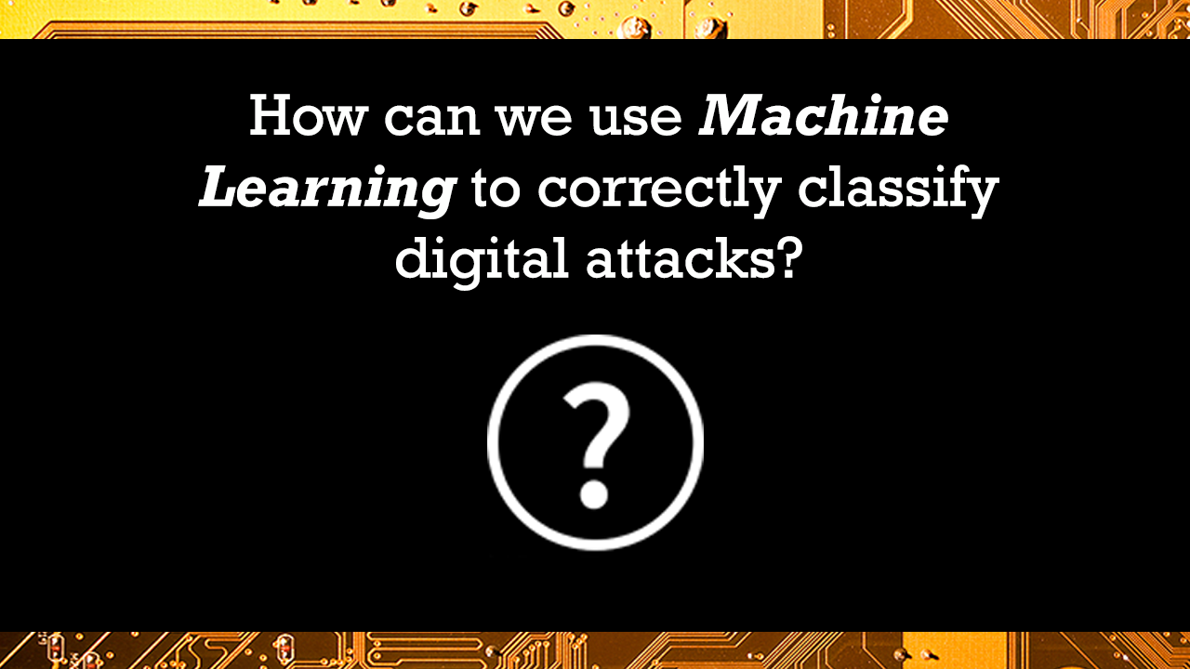
Methods
Flowchart of methodology to approach this specific problem
Which analyses we used, (e.g. imported data, deleted/changed to numerica the categorical, split train set into evaluation, used SVM univariate analysis with k=10 clusters, and assessed accuracy with xyz method, all in python version xyz)
Notes:
Answered question: Given test set* with normal and attack data and parameters, can we create a model that will identify feature types and thus correctly classify attacks?
Specs:
Python version xxx
Data set

Slide 7

Notes:
created by the IXIA PerfectStorm tool in the Cyber Range Lab of the Australian Centre for Cyber Security (ACCS)
hybrid of real modern normal activities and synthetic contemporary attack behaviours.
Tcpdump tool is utilised to capture 100 GB of the raw traffic (e.g., Pcap files). This dataset has nine types of attacks, namely, Fuzzers, Analysis, Backdoors, DoS, Exploits, Generic, Reconnaissance, Shellcode and Worms. The Argus, Bro-IDS tools are used and twelve algorithms are developed to generate totally 49 features with the class label.

Slide 8
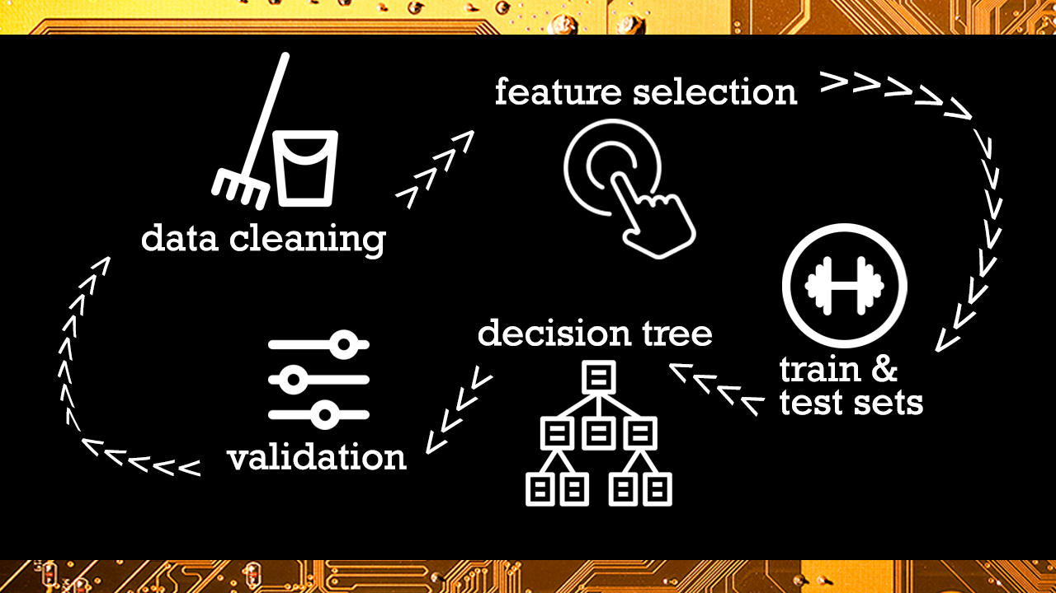
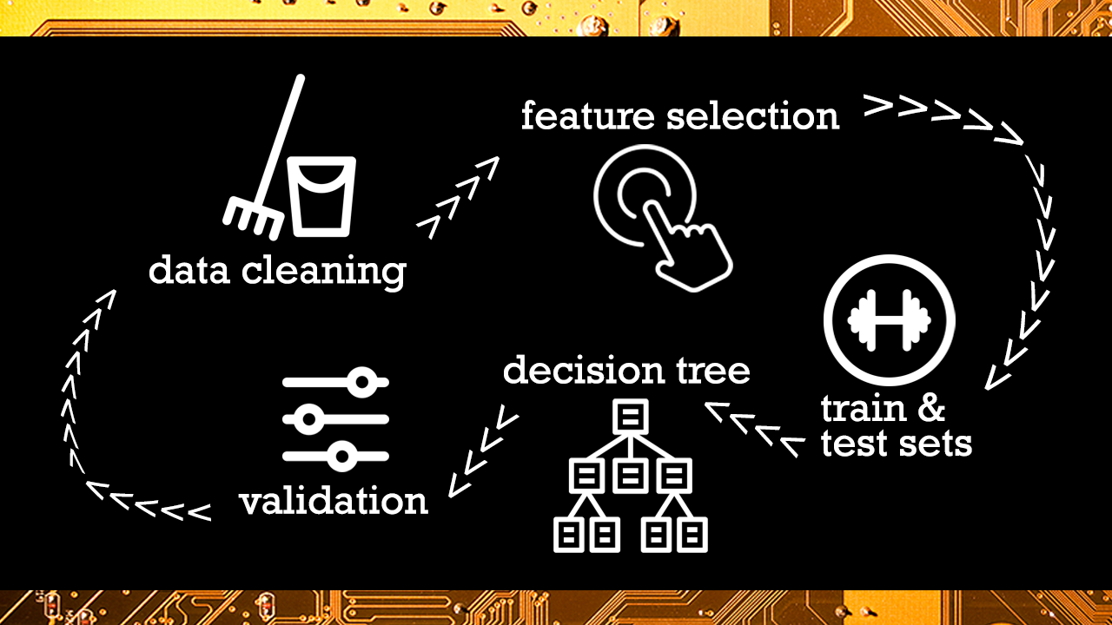
Notes:
Generally, we cleaned the data, selected important features, random forest, validated
This process wasn’t as linear as depicted, we’ll touch more on that in the discussion section

Slide 9

Results
Features of importance, quick description, accuracy numbers

Slide 10

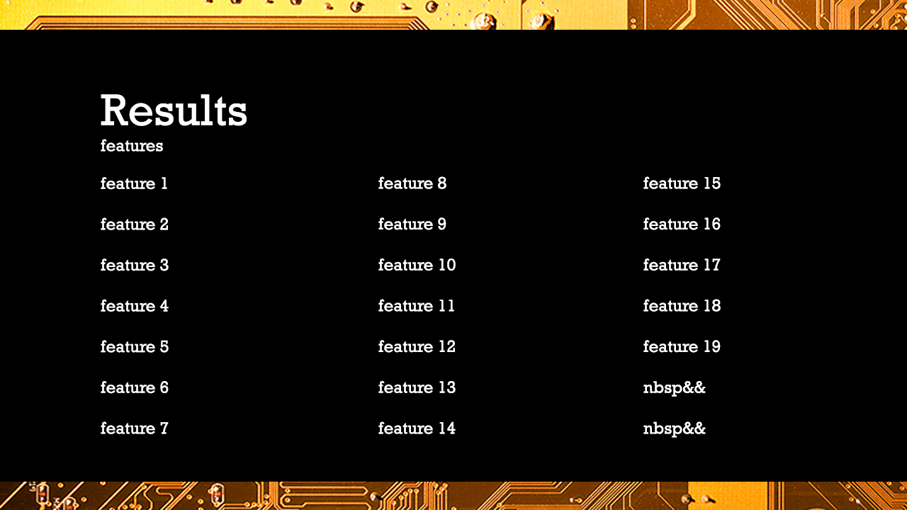


Features listed from random forest
Notes:
*side note* don’t ever tell schooldad i put a pie-esque chart in here
‘spkts', 'dpkts', 'sbytes', 'dbytes', 'rate', 'sttl', 'dttl', 'sload','dload', 'sloss', 'dloss', 'sinpkt', 'dinpkt', 'sjit', 'djit', 'swin', 'stcpb', 'dtcpb', 'dwin', 'smean', 'dmean', 'trans_depth', 'response_body_len', 'ct_srv_src', 'ct_state_ttl', 'ct_dst_ltm', 'ct_src_dport_ltm', 'ct_dst_sport_ltm', 'ct_dst_src_ltm', 'ct_flw_http_mthd', 'ct_src_ltm', 'ct_srv_dst'
Bold = features that we selected but found contributed 0 variance to model
green=contributed more than 10% to the model (22.6% ('ct_state_ttl') and 26.8%('ct_dst_sport_ltm'))

Slide 11
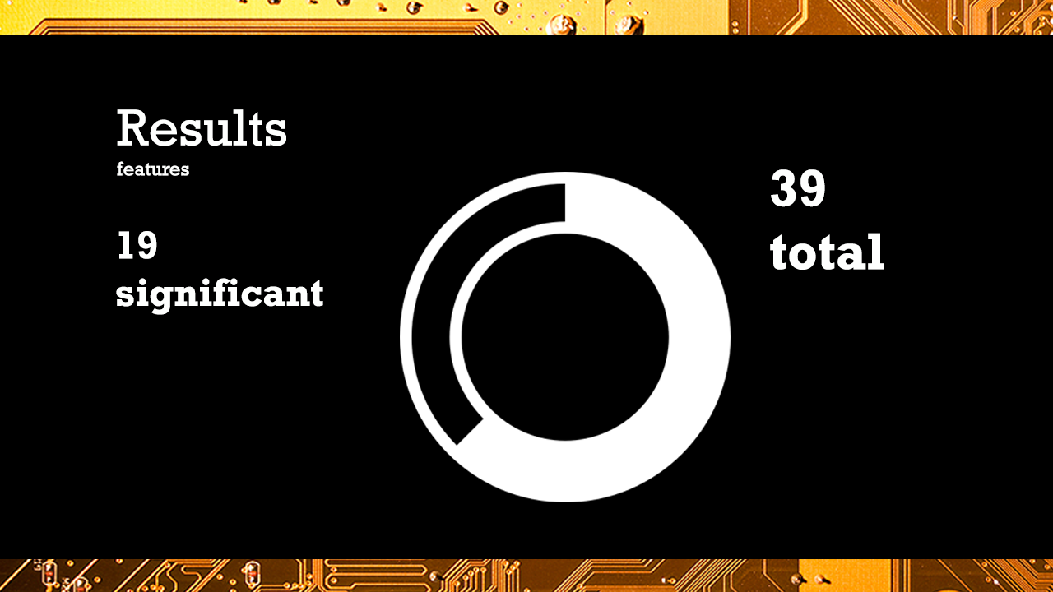

Notes:
‘spkts', 'dpkts', 'sbytes', 'dbytes', 'rate', 'sttl', 'dttl', 'sload','dload', 'sloss', 'dloss', 'sinpkt', 'dinpkt', 'sjit', 'djit', 'swin', 'stcpb', 'dtcpb', 'dwin', 'smean', 'dmean', 'trans_depth', 'response_body_len', 'ct_srv_src', 'ct_state_ttl', 'ct_dst_ltm', 'ct_src_dport_ltm', 'ct_dst_sport_ltm', 'ct_dst_src_ltm', 'ct_flw_http_mthd', 'ct_src_ltm', 'ct_srv_dst'
Bold = features that we selected but found contributed 0 variance to model
green=contributed more than 10% to the model (22.6% ('ct_state_ttl') and 26.8%('ct_dst_sport_ltm'))

Slide 12
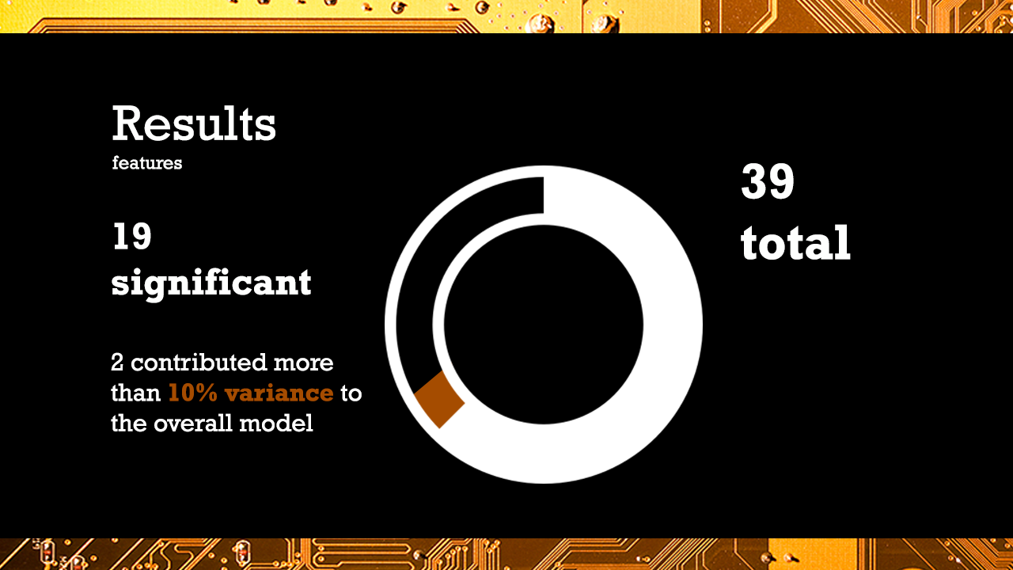
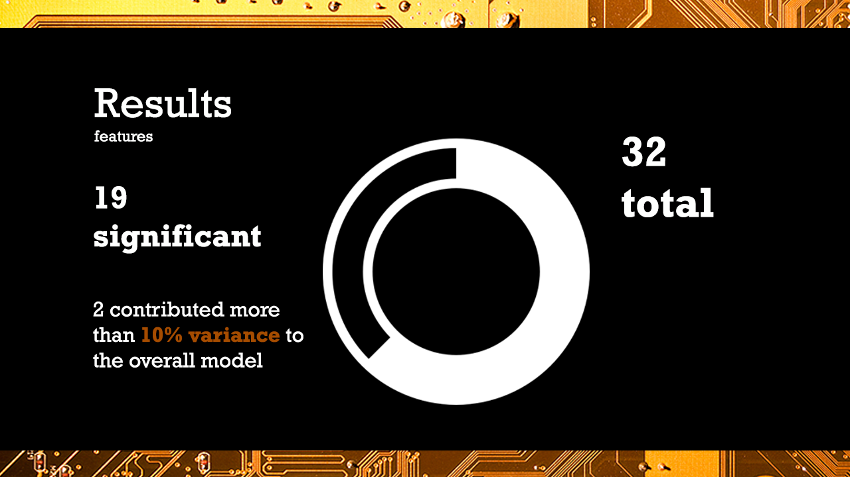

Notes:
‘spkts', 'dpkts', 'sbytes', 'dbytes', 'rate', 'sttl', 'dttl', 'sload','dload', 'sloss', 'dloss', 'sinpkt', 'dinpkt', 'sjit', 'djit', 'swin', 'stcpb', 'dtcpb', 'dwin', 'smean', 'dmean', 'trans_depth', 'response_body_len', 'ct_srv_src', 'ct_state_ttl', 'ct_dst_ltm', 'ct_src_dport_ltm', 'ct_dst_sport_ltm', 'ct_dst_src_ltm', 'ct_flw_http_mthd', 'ct_src_ltm', 'ct_srv_dst'
Bold = features that we selected but found contributed 0 variance to model
green=contributed more than 10% to the model (22.6% ('ct_state_ttl') and 26.8%('ct_dst_sport_ltm'))

Slide 13
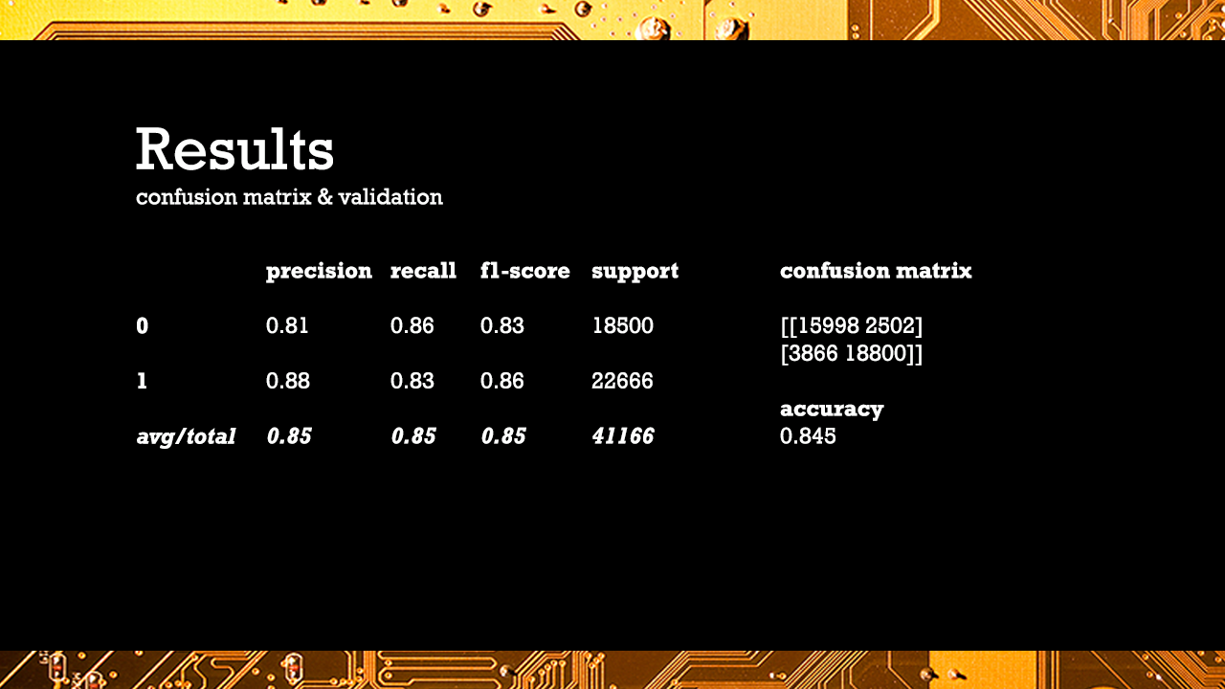

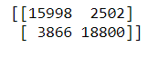
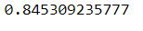
Confusion matrix and accuracy score
Notes:
NEW PLAN: use binary outcome and random forest;
*cue law and order theme song*
Here is the classification report

Slide 14
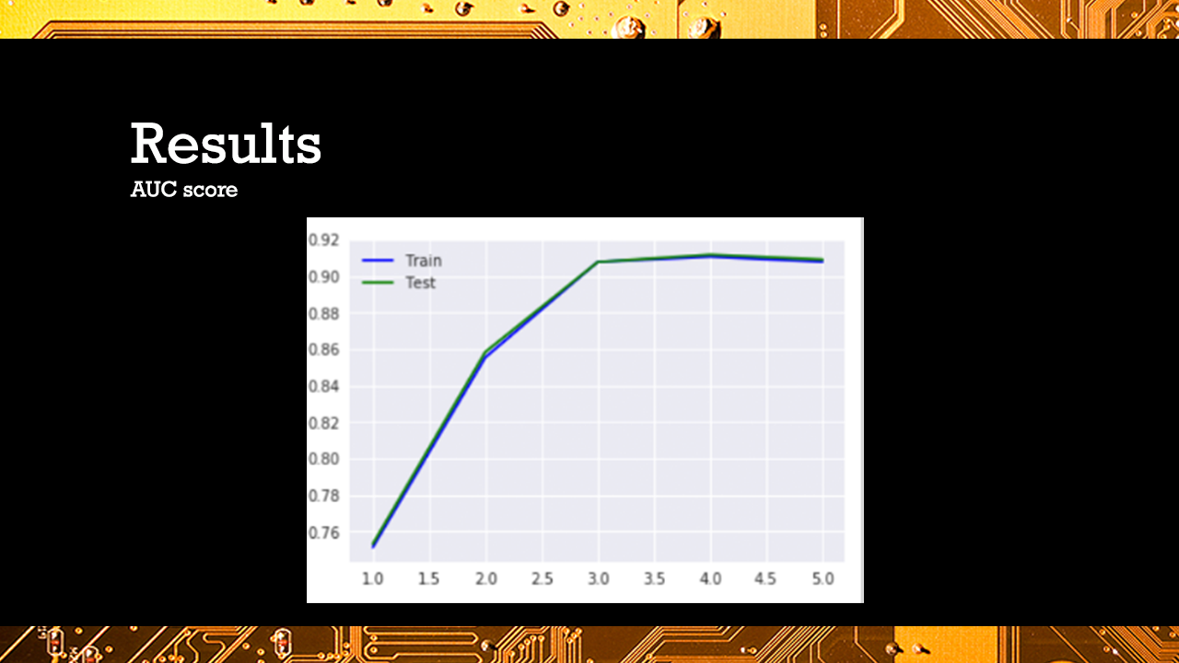
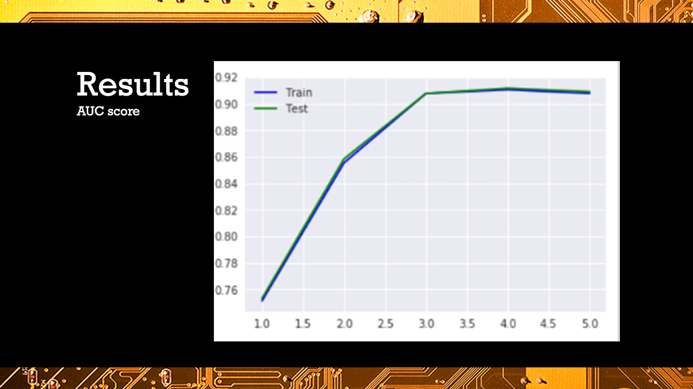

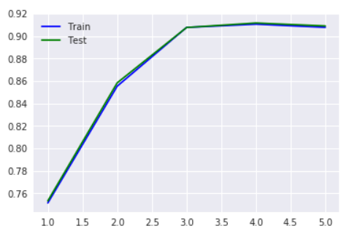
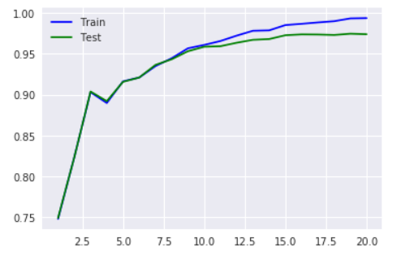
WE GOT A MUTHERFRACKING AUC_ROC SCORE: 0.90898814255431903
Notes:
***this is max_depth
**And I put a new graph on top of there, because I think it makes more sense with how large our dataset is
Shows for the depth of the tree, how well the model is able to predict the training and test set, clearing is almost perf, around a depth of 10 that our model starts to overfit our data
The first parameter to tune is max_depth. This indicates how deep the tree can be. The deeper the tree, the more splits it has and it captures more information about the data. We fit a decision tree with depths ranging from 1 to 5 and plot the training and test auc scores.
I think technically this means overfitting, if the training set is higher than the testing set, but if you look at the y-axis, you see that the training set is hovering around 0.99, and the testing set is hovering around 0.975, so there is little difference between them.

Slide 15
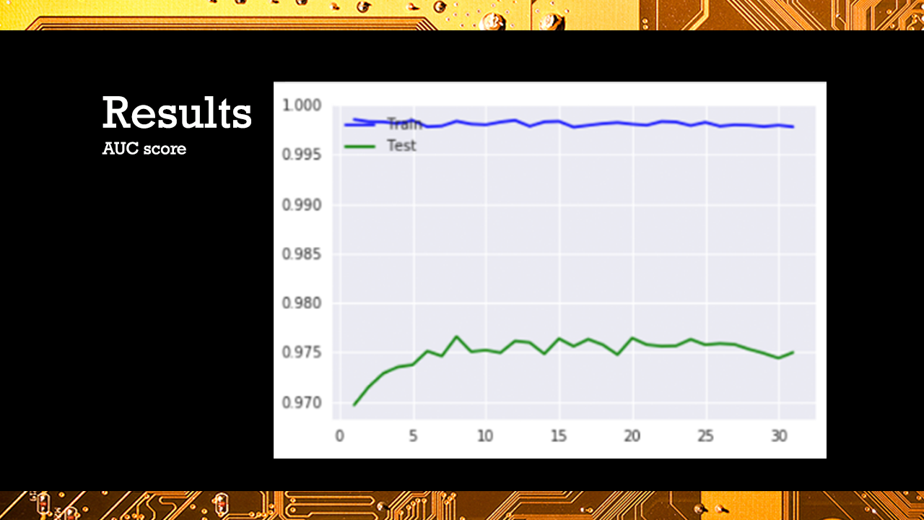


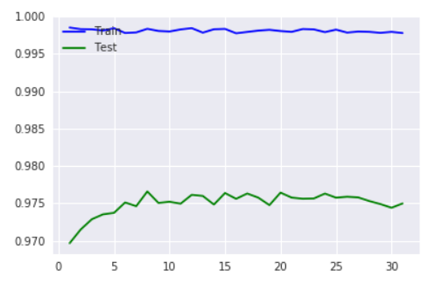
Max_features
Notes:
The first parameter to tune is max_depth. This indicates how deep the tree can be. The deeper the tree, the more splits it has and it captures more information about the data. We fit a decision tree with depths ranging from 1 to 5 and plot the training and test auc scores.
I think technically this means overfitting, if the training set is higher than the testing set, but if you look at the y-axis, you see that the training set is hovering around 0.99, and the testing set is hovering around 0.975, so there is little difference between them.

Slide 16
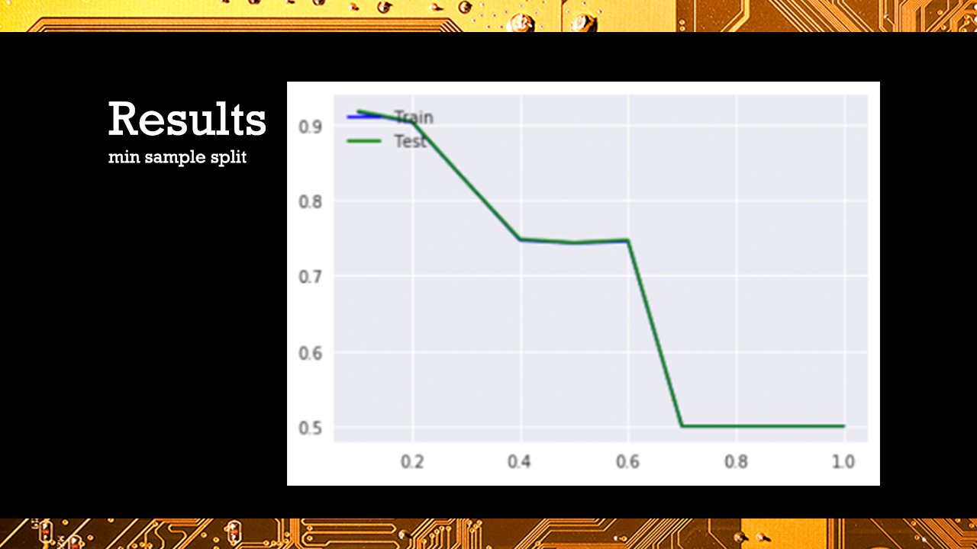
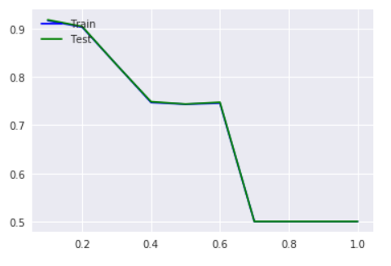
min_sample_split
Notes:
It represents the minimum number of samples required to split an internal node. This can vary between considering at least one sample at each node to considering all of the samples at each node. When we increase this parameter, the tree becomes more constrained as it has to consider more samples at each node. Here we will vary the parameter from 10% to 100% of the samples
Looks like from our graph, with our AUC score being approx. 90%, we are considered about 20% of the data at each node

Slide 17
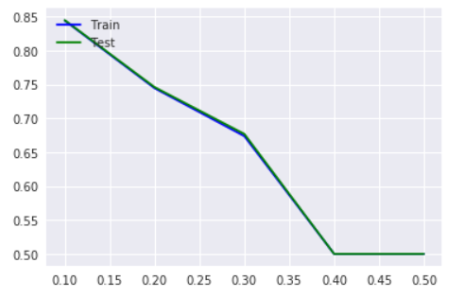
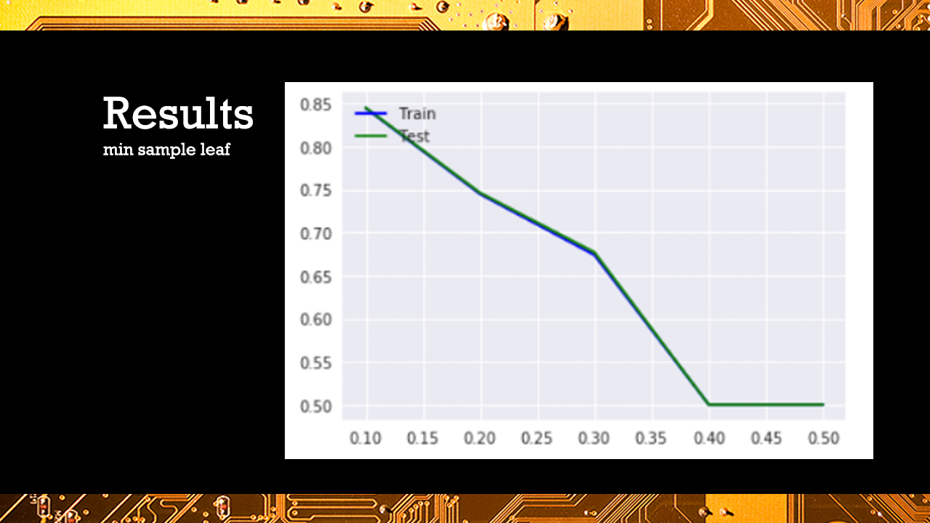
min_samples_leaf
Notes:
This is the minimum number of samples needed at a leaf, so to split a leaf - this makes sense for how detailed our data is, that for our AUC score of 0.9, we are using less than 10% of our data at each leaf, so this is extremely specific. Most likely this model will not fit well when applied to other data.

Slide 18

Discussion
Interesting points (e.g. why we picked k=10 clusters, which feature selection tool, why not data reduction, why delete as opposed to include categorical data, etc.) limitations, further study recommendations
Notes:
Limitations: data is randomly generated, not actual data, imbalanced
In our initial data cleaning, we were able to keep most of our 2.5 million observations; though this makes a lot of sense because our data was generated data, not actual data.
Though, due to size constraints, we had to abandon our lovely cleaned data of 2.5 million observations, for the training and testing set, already pre-cleaned, but UNSW. These datasets were approximately ~300,000 observations in total. After removing columns that had low variances, and performed multivariate feature selection, we ended up with 5 features to predict our outcome.

Slide 19
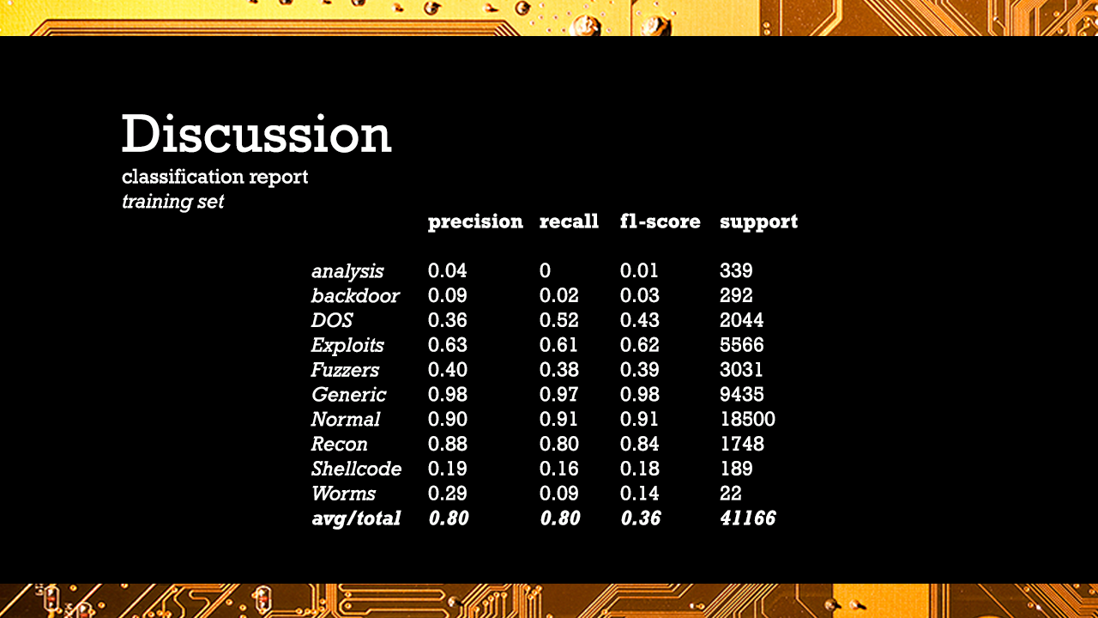
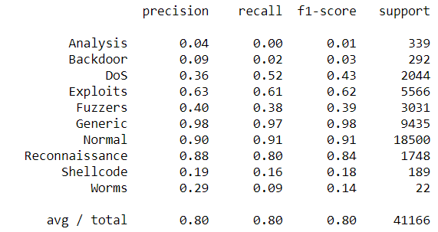
Classification report for our training set
Notes:
honestly our model was better here before feature selection, our precision and recall was 0.97 when we didn’t perform feature selection, but this could be because it allowed our model to be as specific it it’s specific dataset as possible; after feature selection we only needed 5 out of 32 potential columns to predict our attacks

Slide 20
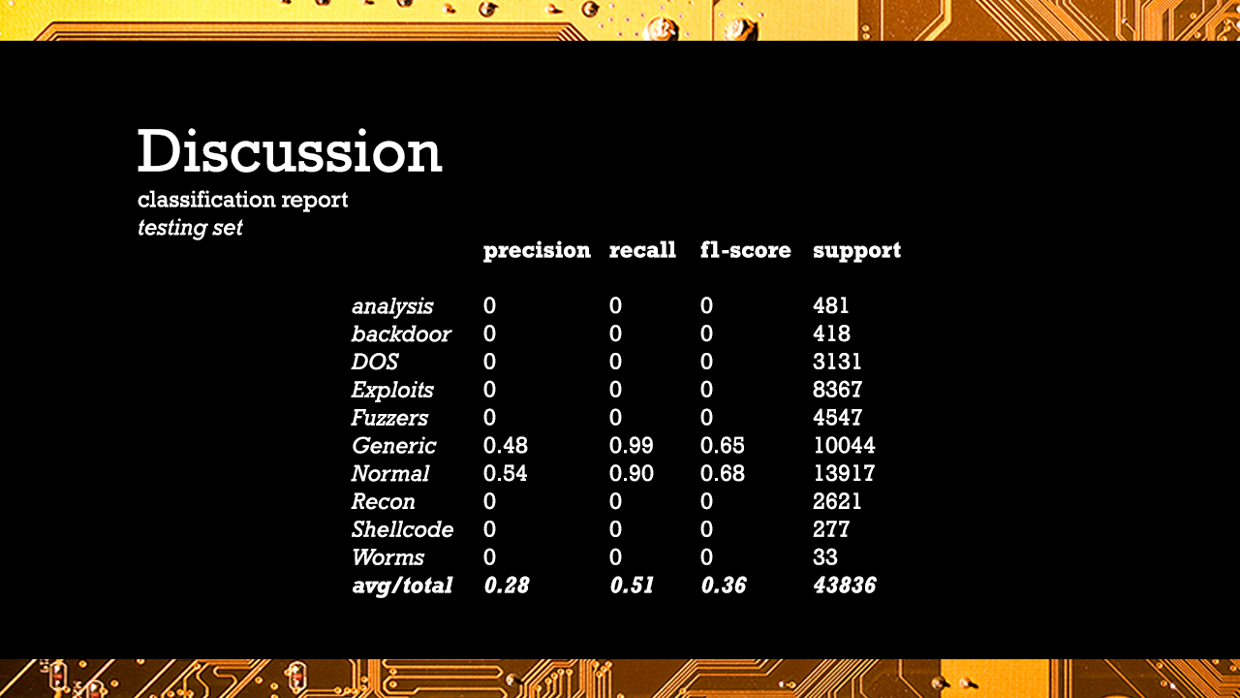
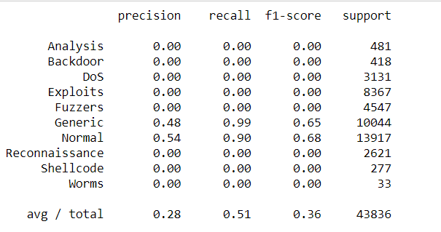
Classification report for testing set
Notes:
This is our classification report when running it on our testing set, and it is pretty abysmal. After multiple attempts to see what was happening with AUC curves, or other types of validation, we could not get the validation code to work on our multiclass data. We conclude that our model is great for our training set, but poor when applied to other models.

Slide 21
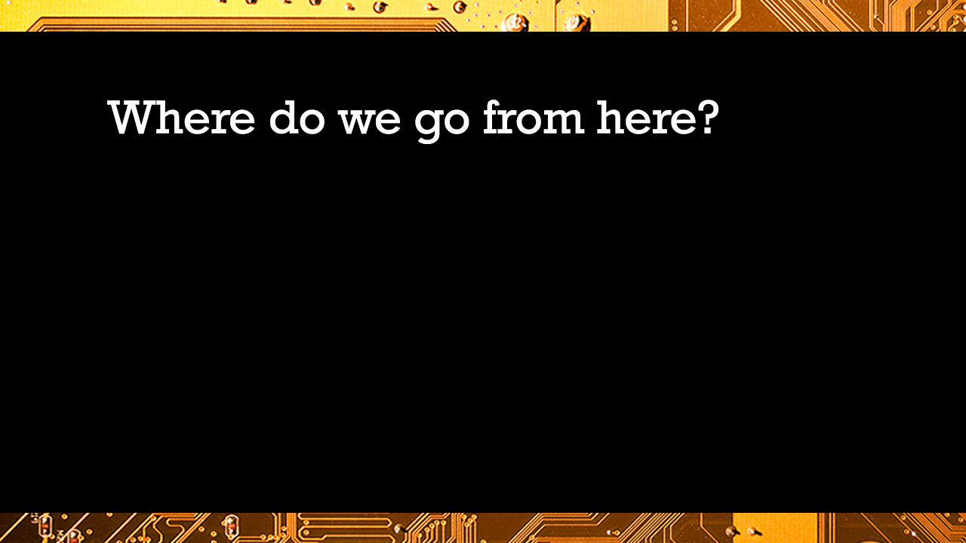

Slide 22
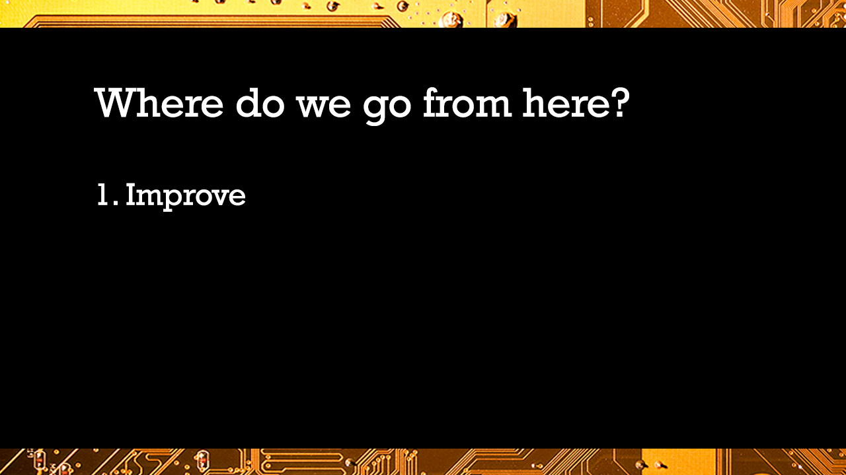
Notes:
Improve model: how to split test and train data, use random forest to account for correlations in data, use different validation tools like AUC, change in size, or more computing power, mostly normal attacks so machine wasn’t good at predicting cyber attacks, simulated data, variables related-descriptions not helpful, for example rate data
Execute: apply to existing data, real time generated data
Inform: how to manipulate data at this size and maintain integrity, how this model works at this capacity
Computing power, names of attacks, neural networks, be able to mobilize and inform, attacks for health data, not just traffic data, speak with someone who is doing database management and security
correlations

Slide 23
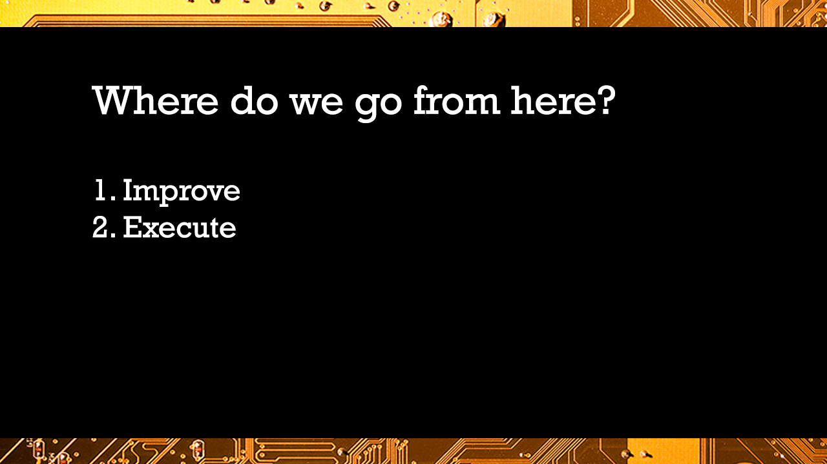
Notes:
Improve model: how to split test and train data, use random forest to account for correlations in data, use different validation tools like AUC
Execute: apply to existing data, real time generated data
Inform: how to manipulate data at this size and maintain integrity, how this model works at this capacity
Computing power, names of attacks, neural networks, be able to mobilize and inform, attacks for health data, not just traffic data, speak with someone who is doing database management and security
correlations

Slide 24
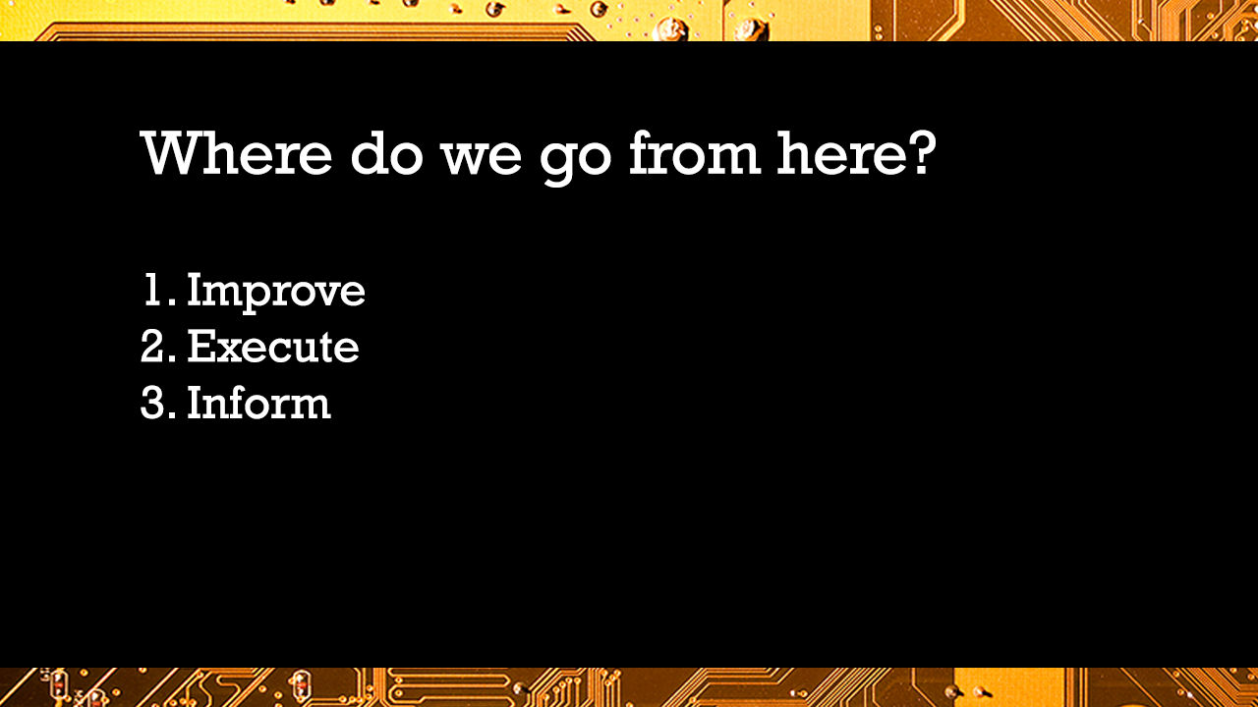
Notes:
Improve model: how to split test and train data, use random forest to account for correlations in data, use different validation tools like AUC
Execute: apply to existing data, real time generated data
Inform: how to manipulate data at this size and maintain integrity, how this model works at this capacity
Computing power, names of attacks, neural networks, be able to mobilize and inform, attacks for health data, not just traffic data, speak with someone who is doing database management and security correlations
Models need to identify features. Future directions should look at different categories of attack. We identified categories of an attack.

Slide 25

Thank you
include paper citations, other references for further interest
Moustafa, Nour. Designing an online and reliable statistical anomaly detection framework for dealing with large high-speed network traffic. Diss. University of New South Wales, Canberra, Australia, 2017.

Slide 26


Notes:
Security by Chameleon Design from the Noun Project
size by d͡ʒɛrmi Good from the Noun Project
Heart by Yorlmar Campos from the Noun Project
Heart by Yorlmar Campos from the Noun Project
help by Shovy Rahman from the Noun Project
Settings by Johan Cato from the Noun Project
cleaning by yurr from the Noun Project
select by Creative Art from the Noun Project
workout by Marek Polakovic from the Noun Project
decision tree by Becris from the Noun Project
Scale by Dan Hetteix from the Noun Project
dashboard by Mani Cheng from the Noun Project
Reuse by Vectors Market from the Noun Project
Moustafa, Nour. Designing an online and reliable statistical anomaly detection framework for dealing with large high-speed network traffic. Diss. University of New South Wales, Canberra, Australia, 2017.

